Slide 1


PREDICTING URBAN TRAFFIC STRESS
USING MACHINE LEARNING
Presented by Janushree S

Slide 2
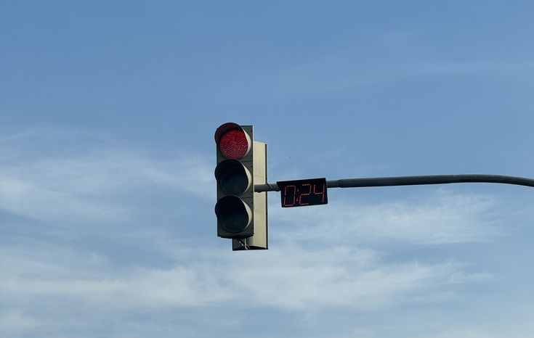
INTRODUCTION
Urban traffic congestion is one of the major challenges faced by modern cities. Long waiting times, frequent stops, noise from vehicles, and crowded roads can significantly increase the stress levels of drivers. High traffic stress not only affects mental well-being but can also reduce driving performance, increase fatigue, and contribute to road accidents.

Slide 3
OBJECTIVES
  To analyze factors influencing urban traffic congestion.
  To predict the level of stress experienced by drivers in urban traffic conditions using machine learning techniques.
  To perform Exploratory Data Analysis (EDA) on traffic data.
  To build and train machine learning models for traffic stress prediction.
  To evaluate different models and identify the best performing model.

Slide 4

DATASET DESCRIPTION
  Dataset Name : smart_city_traffic_stress_dataset.csv
  Total Records:
40,000+ rows (realistic smart- city
simulation)
  Target Variable:
stress_index
(continuous score from ~10 to ~91)

Slide 5

Feature Name | Description
Traffic Density | Vehicles per km (higher = more congestion)
Horn Events per Minute | Honks per minute indicating traffic disturbance
Average Speed | Average vehicle speed in km/h
Signal Wait Time | Seconds spent waiting at signals
Weather Condition | Weather situation affecting driving conditions. (Clear / Rainy / Foggy / Hot)
Road Quality Score | Condition of the road surface. [ 1-10 scale (10 = perfect roads)].
Driver Experience Level | Beginner / Intermediate / Expert
Stress Index (Target Variable) | Level of stress experienced by the driver

Slide 6
DATA PREPROCESSING
  Checked the dataset for missing values.
  Converted categorical variables into numerical format using Label Encoding.
  Applied feature scaling using StandardScaler to improve model performance.
  Split the dataset into training and testing sets for building and evaluating machine learning models.
  Removed outliers using IQR method

Slide 7

EXPLORATORY DATA ANALYSIS (EDA)
  Higher traffic density increases driver stress
  Increase in horn events indicates traffic frustration levels
  Higher average speed reduces stress
  Longer waiting time at signals increases driver frustration
  Better road quality reduces traffic stress
  Experienced drivers handle traffic better

Slide 8
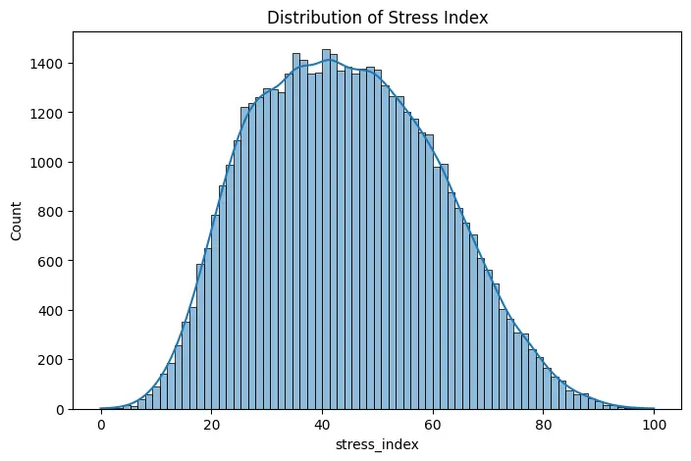
TARGET VARIABLE DISTRIBUTION
  The histogram shows the distribution of the traffic stress index.
  The data follows an approximately normal (bell-shaped) distribution.
  Most values are concentrated between 30 and 60.
  This indicates a balanced dataset for model training.

Slide 9
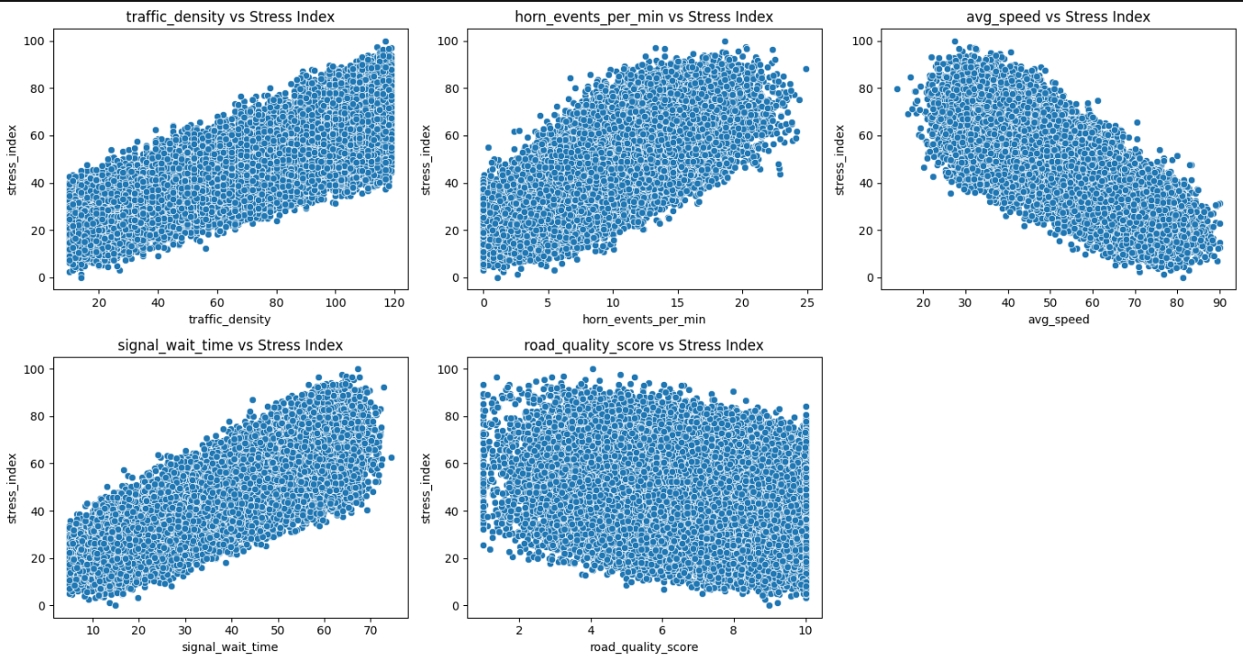
FEATURE VS TARGET (SCATTERPLOTS)

Slide 10
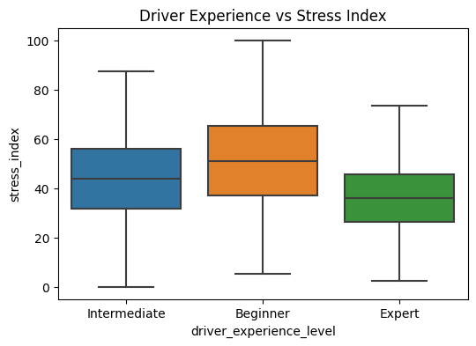
CATEGORICAL VS TARGET (BOXPLOTS)
  Beginner drivers show the highest stress levels
  Intermediate drivers have moderate stress levels
  Expert drivers experience the lowest stress levels
  Stress levels decrease as driver experience increases.

Slide 11
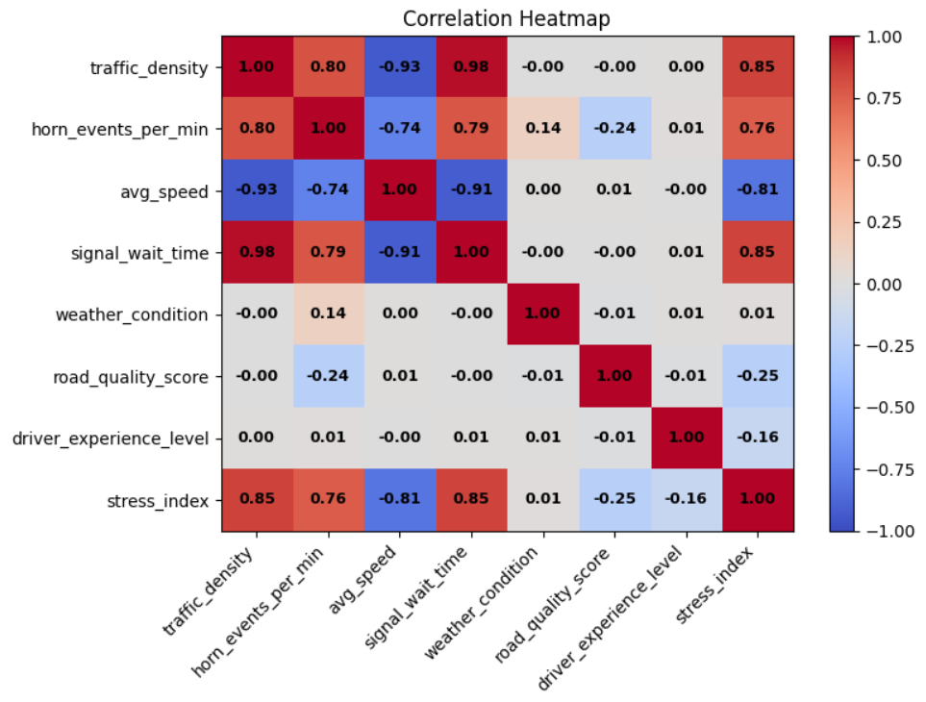
CORRELATION ANALYSIS
  Traffic density, signal wait time, and avg speed are the strongest predictors.
  Traffic density and signal wait time are highly correlated with each other (0.98).
  Weather condition has almost no effect on stress.
  Road quality and driver experience have weak negative correlation with stress.

Slide 12
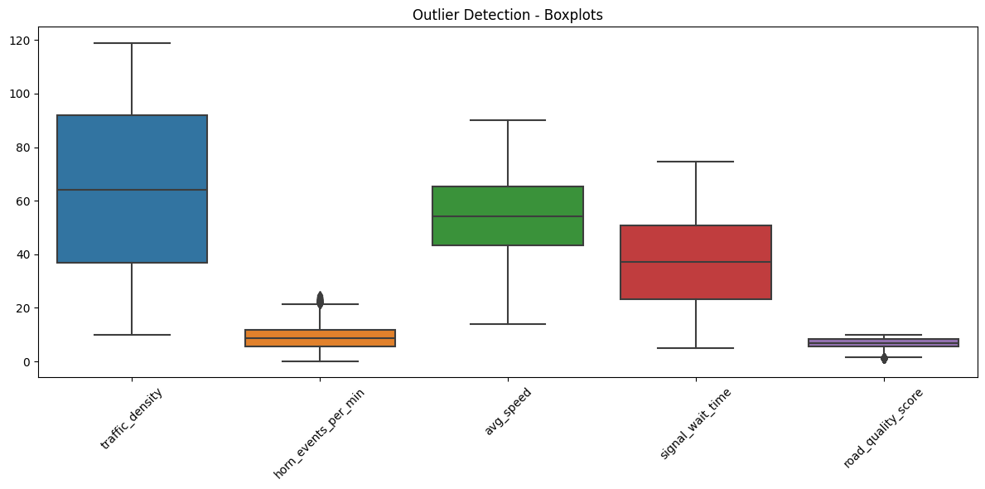
OUTLIER DETECTION BOXPLOTS
Horn_events_per_min and road_quality_score has outliers.
Traffic_density, avg_speed and signal_wait_time have no outliers

Slide 13
MACHINE LEARNING MODELS USED
  Linear Regression
  Decision Tree Regressor
  Random Forest Regressor
  K-Nearest Neighbors (KNN)
  Support Vector Regression (SVR)
  AdaBoost Regressor
  Gradient Boosting Regressor
  XGBoost Regressor
Using multiple models helps determine the best performing algorithm

Slide 14
MODEL EVALUATION
After training the machine learning models, their performance was evaluated using standard regression metrics.
Evaluation Metrics Used:
  R² Score (Coefficient of Determination):
Higher value indicates better performance.
  Mean Absolute Error (MAE):
Lower value indicates better accuracy.
  Mean Squared Error (MSE):
Penalizes larger errors more strongly.

Slide 15
BEST MODEL
SUPPORT VECTOR REGRESSOR (SVR)
  Best performing model:
  Reasons:
Highest test R² score
Good generalization performance
Handles non-linear relationships

Slide 16
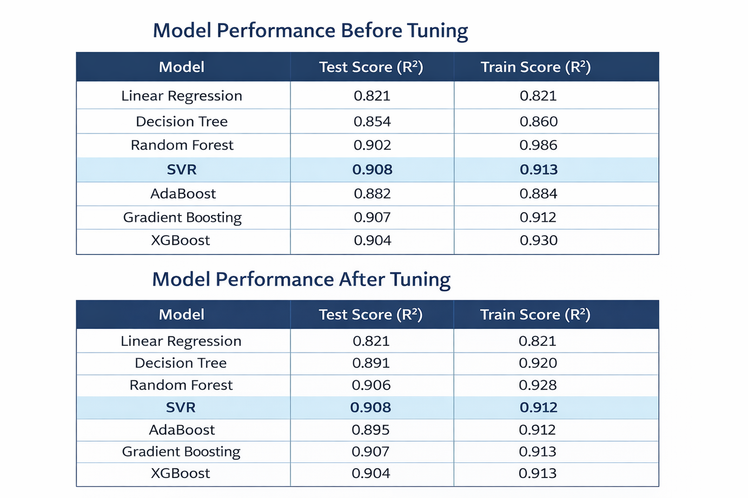
SVR showed stable performance before and after tuning, indicating good generalization.

Slide 17
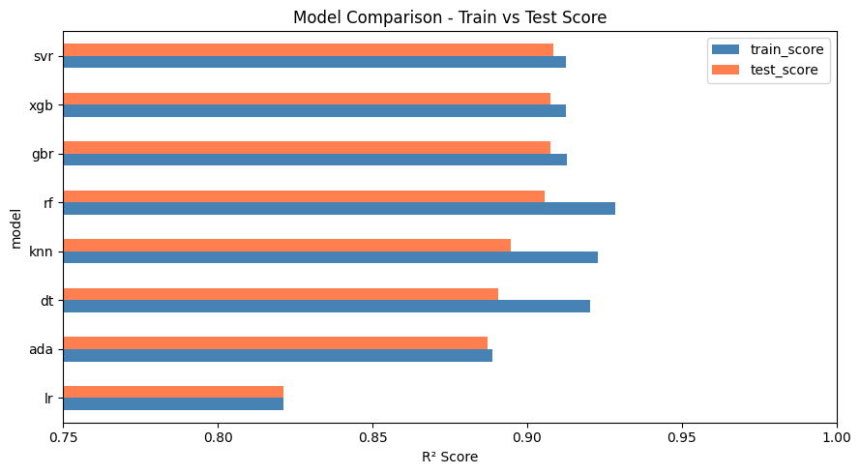

Slide 18
CONCLUSION
  This project demonstrates the effective use of machine learning techniques to predict urban traffic stress levels.
  Exploratory Data Analysis revealed that traffic density, signal wait time, and average speed are the most influential factors affecting traffic stress. Additionally, driver experience and road quality also contribute to variations in stress levels.
  Multiple machine learning models were developed and evaluated. Among them, Support Vector Regression (SVR) achieved the best performance with the highest test accuracy and stable results before and after hyperparameter tuning.
  Machine learning models can accurately predict traffic stress levels and can be used to support efficient traffic management and smart city planning

Slide 19
:)
THANK YOU

